Slide 1
ENGI 301 PCB Project
Liam Merva
Due 1/10/2023 @ 11:59pm

Slide 2
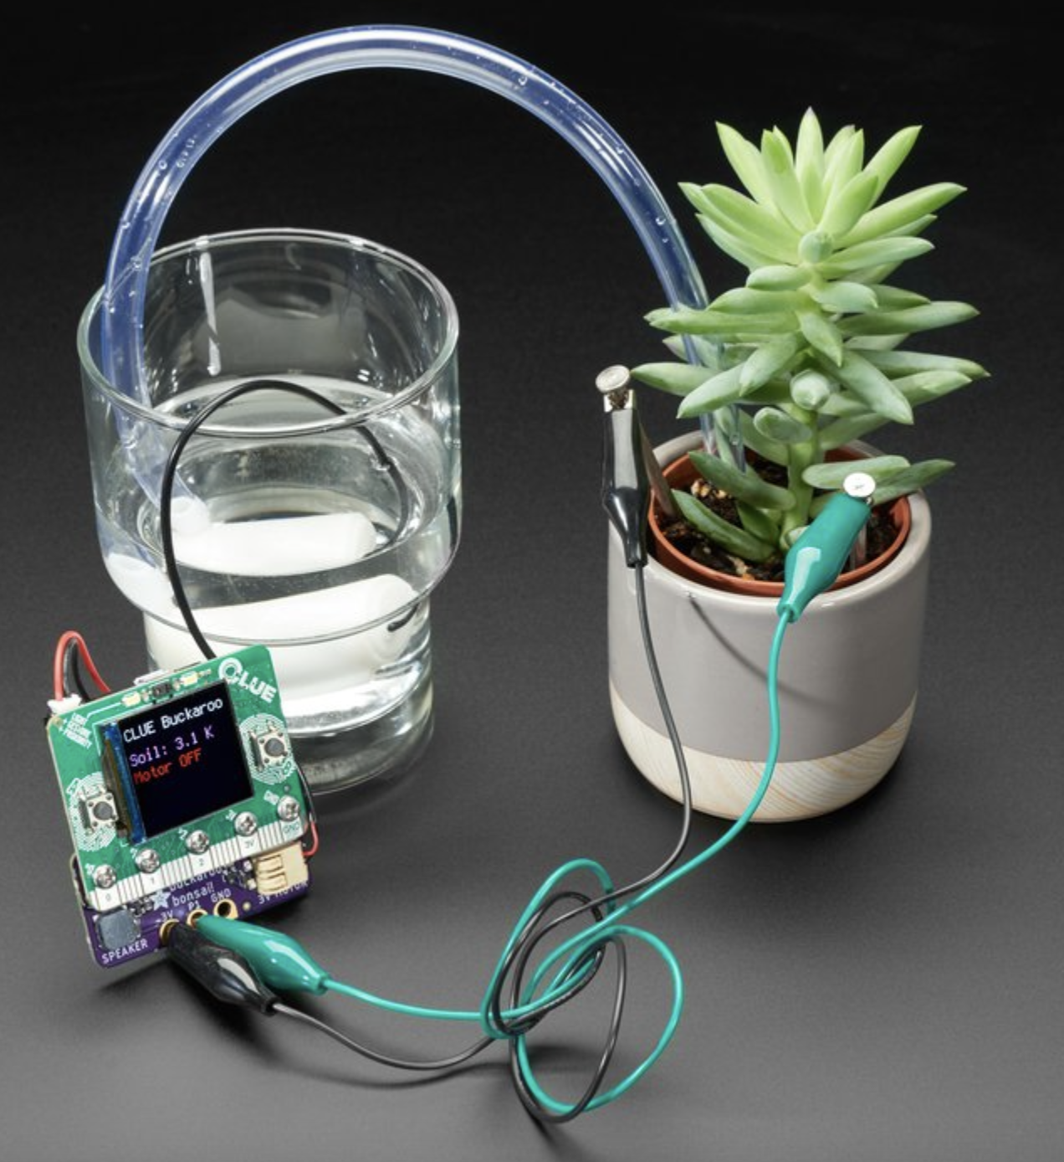
Background Information
Plants are something that always brighten up or improve the aesthetic in a room. There is a innate neurological benefit from keeping nature in close proximity indoors. However, I have always struggled to keep plants because I forget to water/care for them. Thus, I want to not only develop a program to sense when a plant needs water or light, but also automatically delivers water to it when it is required. The only manual labor required would be refilling the water. This is inspired by one of my friend’s quarantine projects where he built a device to water his garden. This also plays into my senior project, where I have to monitor a microenvironment and automatically apply medication/heat based on the circumstances of said environment.
Basing it off a former ENGI 301 project by Fernanda Lago: (https://www.hackster.io/fernandalago/plant-reminder-box-473f95)
Links to existing projects / libraries
Improvements are the automated water dispenser

Slide 3
System Block Diagram
PocketBeagle
1 GND
Submersible 3V DC Water Pump (4547)
63 VDD3v3
61 GND
3 V+
I2C Capacitive Soil Sensor
14 PWM
51 I2C2SDA
SPICLK
TFT LCD Touchscreen
ILI9341
49 I2C2SCL
MISO
MOSI
CS
D/C
23 AIN0
Light Sensor
TEMT6000
Glikfun 5 mm LED Light
EK8437
35 GND
20 GND
33 PWM
18 VDD3V3

Slide 4
Mechanical Drawing
5”
5”
LED
5 mm
2.6 mm
3.2”
Light Sensor
Hex Display
2.2 mm
Pocket Beagle
USB
2.8”
4”
4”
Pump
23.5 mm
Moisture Sensor
0.5”
3”
FRONT
BACK

Slide 5
Example Mechanical Drawing (from Combo Lock)
3”
”
.25”
Hex Display
Pocket Beagle
.5”
USB
2”
Button
Buzzer
Pot
Servo
1.5”
FRONT
BACK
Remove this slide in your submission

